Slide 1


Music Mix: Enhancing the Music Streaming Experience
Team Members:
Shivani Goud Pandula
Shivaram Reddy Palla
Srinadh Bokkisam
Sayendranadh Chowdary Devabhaktineni
Rajkumar Chigurupati
Sathvik Cheruku

Slide 2
Outline
Introduction
Problem Statement
Proposed Solution
Functional Requirements
Non-Functional Requirements
Demo (If Any)
What Have Been Accomplished?
Lessons Learned

Slide 3
Introduction
Music Mix aims to enhance user experience on music streaming.
1
Identified key features missing in platforms like Gaana.
2
Goal: Address gaps, create a more user-friendly experience.
3

Slide 4
Problem Statement
Current platforms lack essential features hindering user satisfaction.
Identified Issues:
Can't Search by Lyrics
No Song Recognition by Audio
Limited Recommended Songs
Impact on User Experience:
Harder to Discover New Music
Less Interactive Experience
Missed Opportunities for Personalization

Slide 5
Proposed Solution
Address identified issues to revolutionize music streaming experience.
Features to implement:
Search by Lyrics
Personalized songs , Download Songs
Improved Recommendation System
Conclusion: Aim to make music discovery more engaging, intuitive, and personalized.

Slide 6
Functional Requirements
User Authentication and Registration
Password Reset
User Profile Management
Music Discovery and Playback
Playlist Creation and Management
Social Interaction
Personalized Recommendations
Offline Playback
User Management
Content Management
Support and Communication

Slide 7
Non-Functional Requirements
Performance:
Streaming Efficiency
Response Time
Scalability
Security:
Data Encryption
Authentication
Authorization
Data Privacy
Availability:
Continuous Availability
Fault Tolerance
Usability:
Intuitive Interface
Mobile Responsiveness
Code Documentation:
Comprehensive Documentation

Slide 8
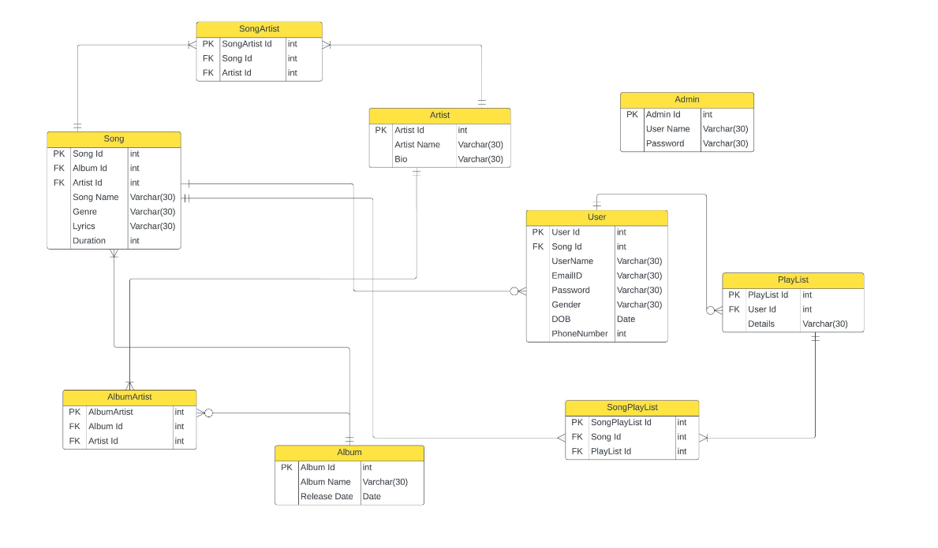
Initial data management plan
Database Schema Design:
Manage the various types of data, including users, songs, playlists, albums, artists, and admin users.
User Authentication Management
Music Management
Social Interaction Management
Backup and Recovery Procedures

Slide 9
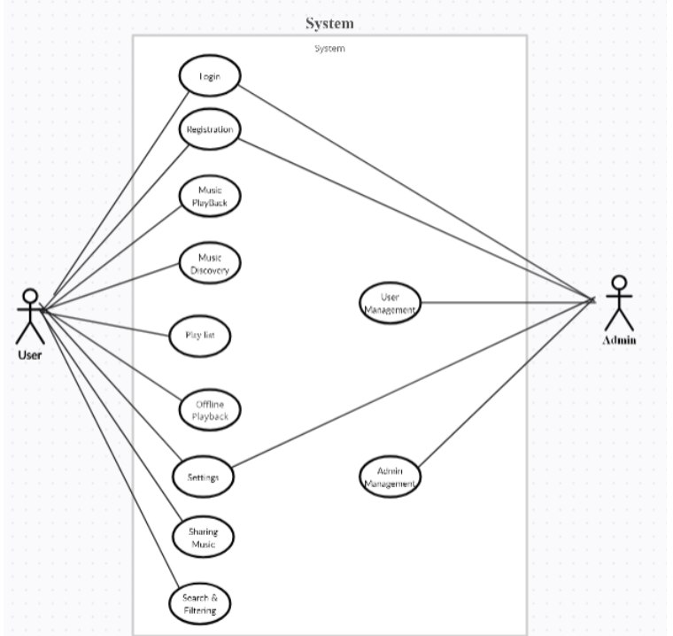
Usecase Diagram
Initial thoughts on solution:
It is a Web Application where the user can able to search, edit, delete, personalized playlist, Albums, Artist etc.
The preferred technologies are springboot, HTML, mysql etc.

Slide 10
What Have Been Accomplished?
Lessons Learned:
Implemented user authentication and registration.
Identified functionalities of MusicMix and Possible ways for Implementation.
MusicMix project Documentation is prepared and Updated on Github
Usecase diagram is determined
Importance of user feedback in feature prioritization.
Challenges in implementing real-time song recognition.

